Slide 1
SJ Classroom Analytics
February 2018

Slide 2
Housekeeping Items

Slide 3
Today(s) Timing/Flow
8:45 to 10:00am:
The New FORGE Analytics Portal
10:00 to 10:15am:
Break
10:15 to 12:00pm:
New Standard Report Review
12:00 to 1:00pm:
Lunch (Mmmm Mmmm!!!)
1:00pm to 1:30pm:
When will these be deployed?
1:30pm to 2:00pm:
What’s Next/New in the Analytics Roadmap
Wrap Up

Slide 4
Goal(s) for today: Better Understanding of
The New FORGE Analytics Portal and its enhanced features
The New Standard Reporting Package and its contents
When will BSA begin deploying?
What additional training will be offered?
What other awesome/amazing/stupendous stuff is Blacksmith Applications targeting in 2018 related to Analytical Features?

Slide 5
The New FORGE Analytics Portal

Slide 6
New Portal: Why?
Why provide a new portal to access FORGE Analytics?
Easier to use!!!!!
Newest Release/Patch for all clients with most up to date functionality
Accessibility
Intuitive Design
Centralized Report Location
Dynamic Searching
Simplified User Account Options
Streamlined Export/Scheduling

Slide 7
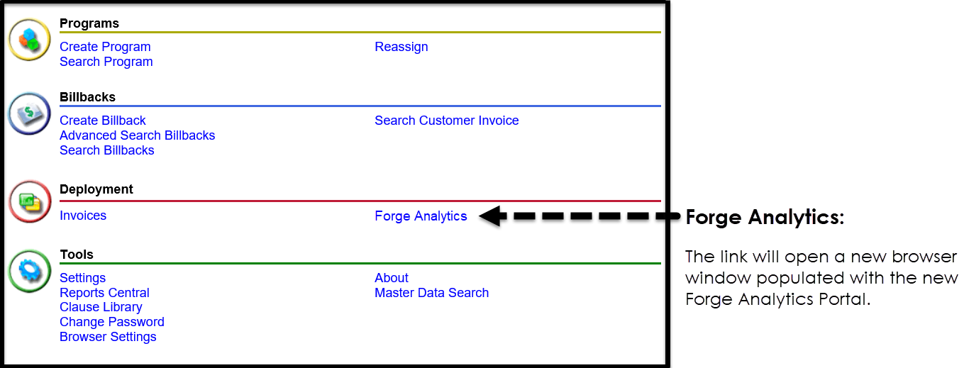
New Portal: Accessible from FORGE

Slide 8
New Portal: Review
Let’s Take a look

Slide 9
Break

Slide 10
New Standard Analysis Package

Slide 11
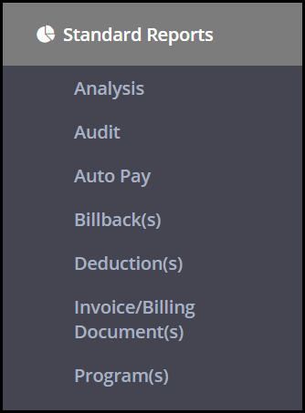
New Standard Package
New Analytics Report Package Count by Type:
Analysis = 126
Audit = 10
Auto Pay = 5
Billback(s) = 70
Deduction(s) = 23
Invoice/Billing Document(s) = 19
Program(s) = 26

Slide 12
New Standard Package
Let’s Take a look

Slide 13
LunchBreak

Slide 14
Deployment Timing & Training

Slide 15
Deployment Timing
Enhanced FORGE Analytics Portal & New Standard Report Deployment
Begin deploying to clients subscribed to FORGE Analytics next month
Targeting fully completed deployment by end of July 2018
Provide an estimated deployment week/month to each of our clients by end of March.

Slide 16
Deployment Training
Training for Portal:
PDF Training documents will be created and posted within folders in FORGE Analytics so users can access as they are in the application.
Online video training will be created and made available as it is completed
Additional live online training will be provided at time of rollout as a refresher related to how to use the portal
Training for Standard Reports:
PDF Informational documents will be created and posted within folders in FORGE Analytics so users can access as they are in the application.
Group Online meetings will be setup to review Standard Report Folders and the contents of those folders in greater detail.

Slide 17
What else is coming in 2018?

Slide 18
What else is coming?
BSA commissioned a project with McKinsey & Company which spanned several months to understand how we can create better insights and drive increased profitability for our customers.
Out of this project EMBER was created which is a NEW Analytics Product which will be entering Beta soon
Why EMBER? Let’s take a look…

Slide 19
Goals Recap & Wrap Up

Slide 20
New Portal: Goal #1 Recap
Leave with a better understanding of the New FORGE Analytics Portal and its enhanced Features?
Simplistic/Intuitive Design = Easier to User
Accessible from the FORGE Application via Single Sign On
Easy Access to all my folders, my inbox, and new report creation
Easier Viewing Options to find the report I need to analyze my business
Dynamic Searching with ability to access the results of my search at all times
Scheduling reports is now much more accessible and intuitive
One location to view all of my scheduled reports
Easy to reset my password

Slide 21
New Standard Reports: Goal #2 Recap
Leave with a better understanding of the New FORGE Analytics Standard Reports?
Learned what folders of reports are available and the general grouping of each
Learned what reports comprise each folder
Reviewed in detail a handful of reports
The new library of reports is not stagnant and grows as Blacksmith creates

Slide 22
Deployment: Goal #3 Recap
Leave with a better understanding of when this will be deployed?
Blacksmith will begin deploying to clients subscribed to FORGE Analytics next month
They are targeting fully completed deployment by end of July 2018
I should get an estimated deployment week/month by the end of March.

Slide 23
Training: Goal #4 Recap
Leave with a better understanding of will there be additional training offered?
For the Portal BSA will be providing:
PDF Training documents which a user can access in FORGE Analytics which will show them how to use
Online training videos and will make available as they are completed
Additional live online training at the time of rollout to my organization
For the Standard Reports BSA will be providing:
PDF Informational documents which can be accessed in FORGE Analytics if they have questions related to the contents of a report
Group Online meetings will be setup to review Standard Report Folders and the contents of those folders in greater detail.

Slide 24
What Else: Goal #5 Recap
Leave with a better understanding of what other awesome stuff BSA is doing around Analytics in 2018?
BSA commissioned a project with McKinsey & Company which spanned several months to understand how we can create better insights and drive increased profitability for our customers.
Out of this project EMBER was created which is a NEW Analytics Product which will be entering Beta soon

Slide 25
THANK YOU!!!!
For being such great clients!!!

