Slide 1
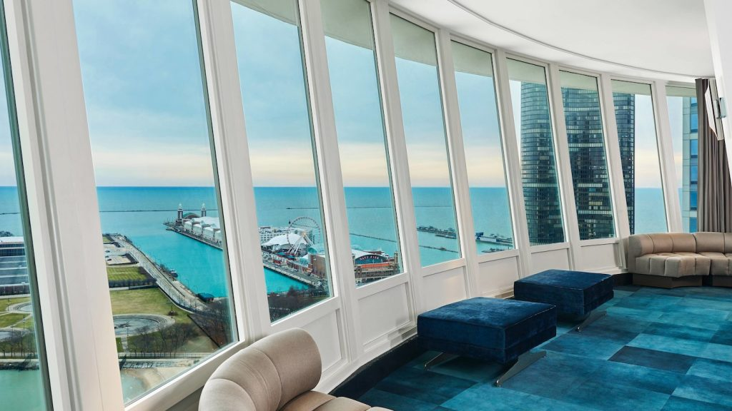

Smoke Jumpers XVIII
W Chicago Lakeshore
Chicago - May 9, 2019
Notes:
**Master Deck**

Slide 2
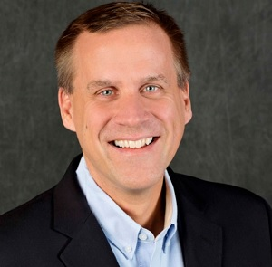

Welcome & Opening Remarks
Paul Wietecha
President & CEO, Blacksmith
Notes:
30 min

Slide 3

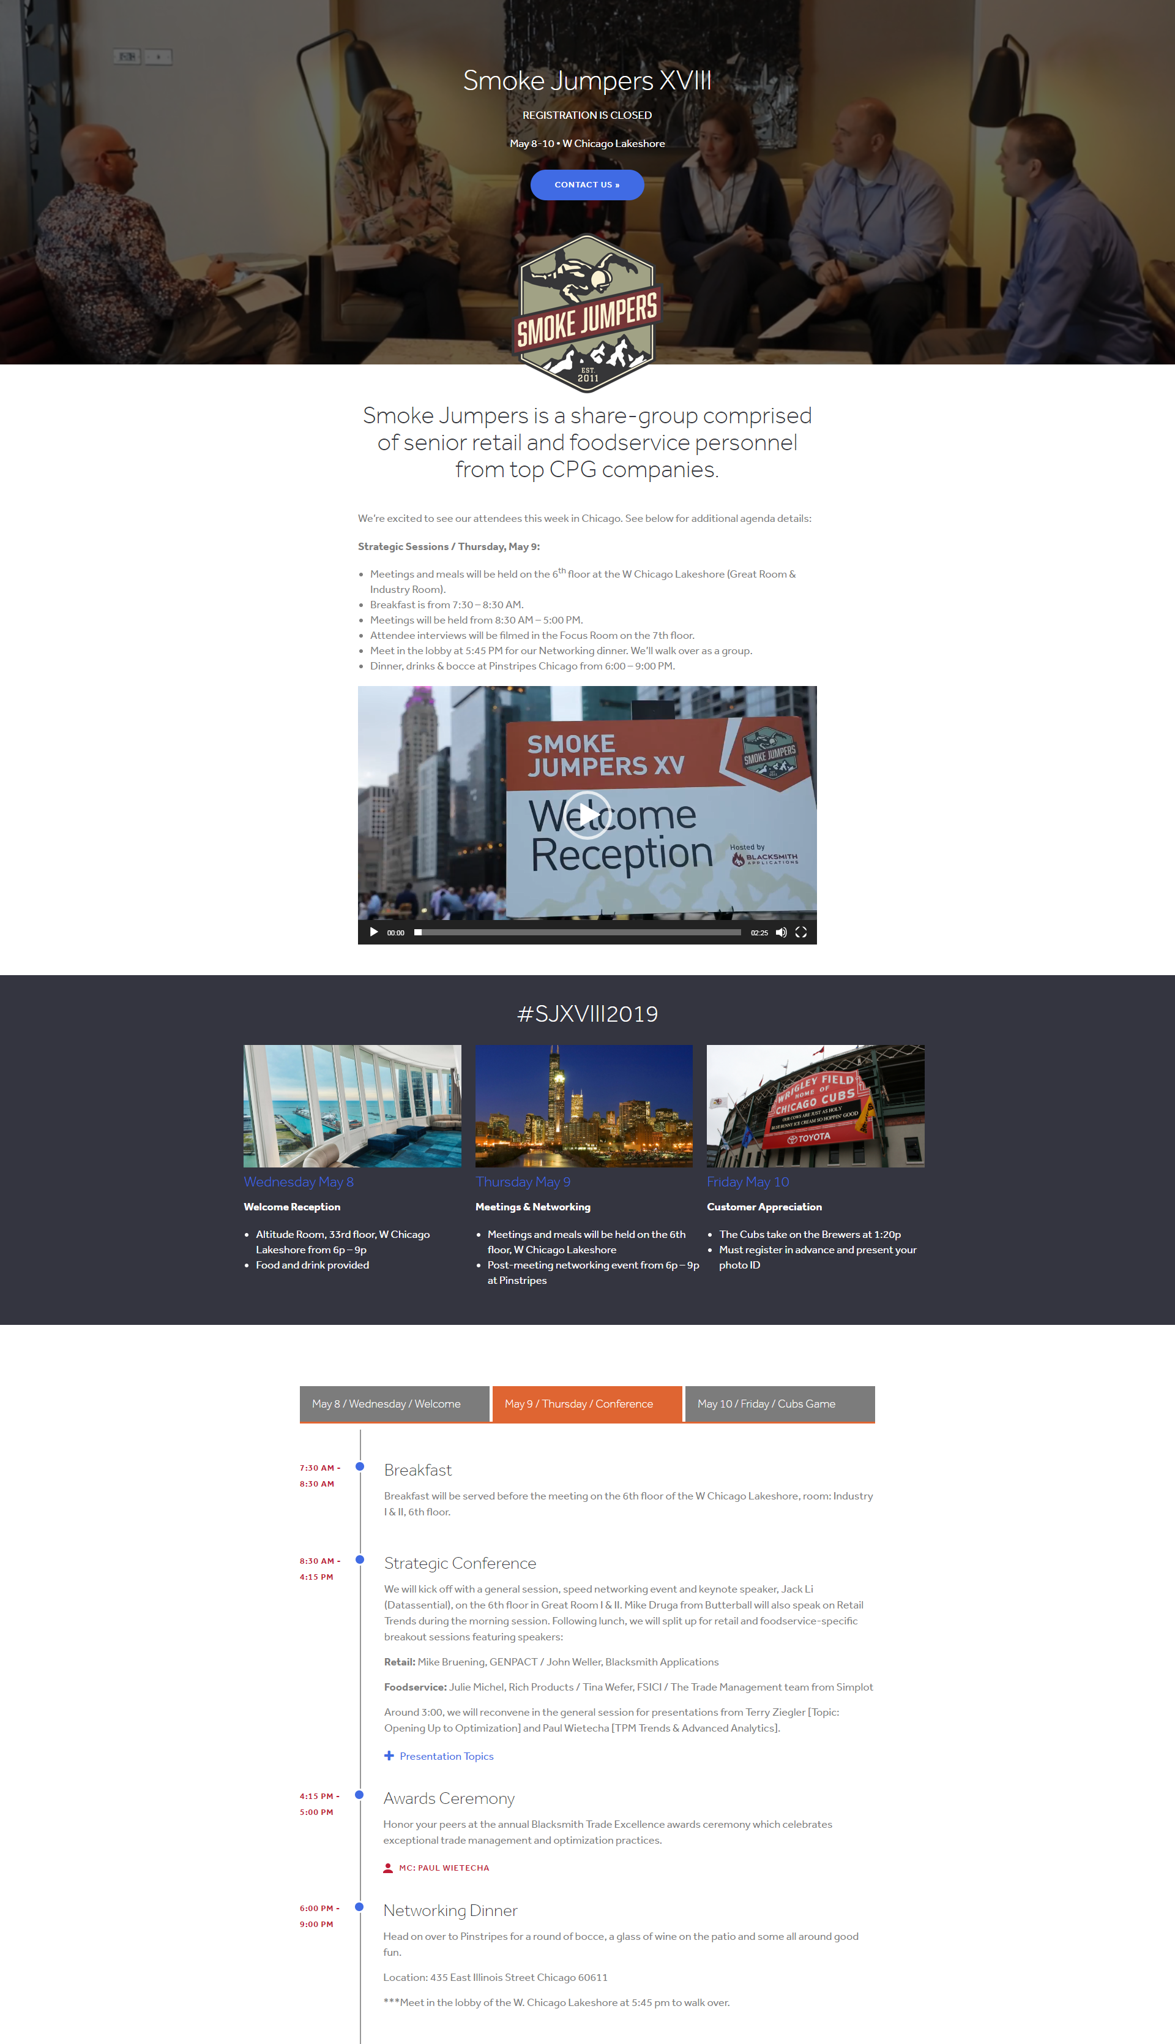
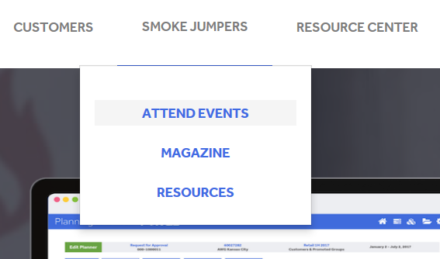

Conference Info Online
Visit the event page online for more information.
http://blacksmithapplications.com/smoke-jumpers-2/attend-smoke-jumpers/
Toggle between days for timelines & locations
Notes:
Caitlin to present

Slide 4
Meeting
Education on industry trends
Solutions for common opportunities
Networking among peers
Notes:
Caitlin to present

Slide 5
Education & Solutions
Keynote: The changing world of consumer tastes
Foodservice
Leveraging Operator Data
Foodservice GPO’s
Claims Processing Efficiency
Redistribution
Grocery & Retail
Retail Industry Trends
AI & Machine Learning
Promotion Optimization
Post Event Analysis
Notes:
Caitlin to present

Slide 6

Agenda
Morning | Appx: | Session Title | Speaker | Company
General Session: | 60 min | Speed Networking | Caitlin Orosz | Blacksmith Applications
 | 90 min | Datassential Keynote | Jack Li | Datassential
 | 45 min | Retail Trends | Mike Druga | Butterball
Lunch | noon | *return to Industry Rooms*
Appx 8:30 – 12:00
Afternoon | Appx | Session Title | Speaker | Company
Foodservice Breakout: | 20 min | Claims & Proof of Delivery Automation | Julie Michel | Rich’s
 | 30 min | 9.3 Million Reasons | Tina Wefer | FSICI
 | 40 min | Redistribution Chat | Simplot Team | Simplot
Retail Breakout: | 45 min | Addressing Post-Event Analysis Challenges | John Weller | Blacksmith Applications
 | 45 min | AI & Machine Learning Impact on CGs | Mike Bruening | Genpact
General Session: | 45 min | Opening up to Optimization | Terry Ziegler | Blacksmith Applications
 | 45 min | TPM Trends & Advanced Analytics | Paul Wietecha | Blacksmith Applications
4:15 PM - Wrapping up with a quick break & the Blacksmith Applications Trade Awards Ceremony
Networking Dinner:
6pm – 9pm
Pinstripes:
435 E Illinois St, Chicago, IL 60611
Meet in the hotel lobby at 5:45 to walk to Pinstripes for bocce, dinner & drinks.
Breakouts from appx 1:00 – 2:30
Breakouts from appx 1:00 – 2:30
Appx 2:30 – 4:15
Notes:
Caitlin to present

Slide 7

Breakout Session Details
RETAIL
Addressing Post-Event Analysis Challenges
While today’s CPG companies have more data than ever, most still struggle to gain actionable insight to impact their business success. We’ll share best practices and experience in: common data challenges, data management priorities, misconceptions in data cleansing and harmonization, and the future of data and data science in CPG.
The Impact of AI and Machine Learning on Consumer Goods Companies:
What is Artificial Intelligence and Machine Learning and what are the likely near term and long term impacts for these technologies in CPG? Explore the history and emerging trends of AI and Machine Learning with case studies and an interactive Q&A
NOTE: Retail breakouts will be captured on video for future viewing
Notes:
Caitlin to present

Slide 8

Breakout Session Details
FOODSERVICE
Claims & Proof of Delivery Automation:
How Rich Products upgraded systems to improve their deductions cloud. Learn what it takes to automate research and resolution of trade and non-trade deductions with FORGE and High Radius.
9.3 Million Reasons to Take Action
Following landmark judgement against Foodbuy, FSICI is seeking input into practical and feasible solutions that the industry can implement to better report and pay on GPO programs and reduce double-dipping.
Redistribution Group Chat
The team at Simplot will lead a the foodservice attendee group in a discussion on hot topics related to redistribution business challenges, ultimately sharing the secret to tracking profitability with redistribution.
Notes:
Caitlin to present

Slide 9
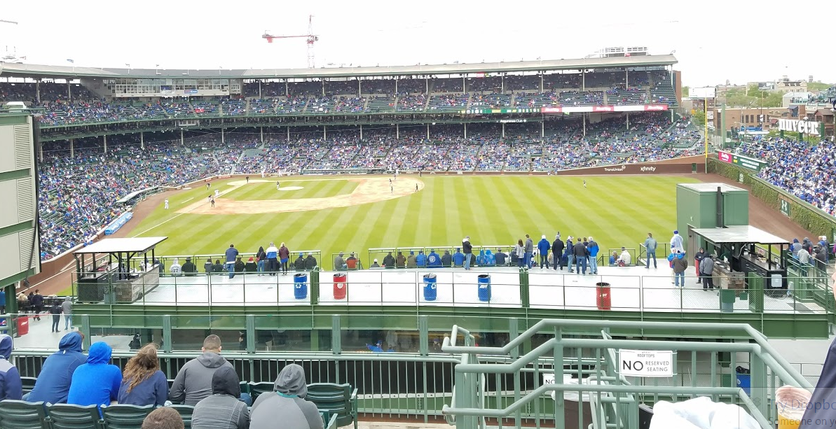
CUBS GAME TOMORROW
Annual customer appreciation event
Wrigley Rooftops venue
Food & Drink provided
Bags can be stored on site
You MUST bring a photo ID to enter the building
You MUST be on the guest list to enter the building
This event is SOLD OUT. If you wish to add yourself or someone you know to the waitlist, please speak with Caitlin Orosz
Location: 3639 Sheffield
Doors open at 1:00 pm
First pitch at 1:20 pm
Wear your Blacksmith ballcap!
Notes:
Caitlin to present

Slide 10
Insert Intro Slides Here
Paul – anything to add?

Slide 11
Speed Networking
The Smoke Jumpers community is growing – meet your peers!
You received your group assignment at registration.
15 conversations for about 3 minutes each.
Questions & prompts:
  Introduce yourself (name, company, role, which Blacksmith application do you use/ how do you interact with it?)
  Are you a first time attendee? Customer? Non-customer? What are you looking to get out of the event?
  What do you want people to know about you? What would you like to learn?
Notes:
Caitlin to present

Slide 12
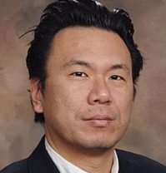

Datassential Keynote
Jack Li
Datassential
Notes:
30 min

Slide 13
Datassential Keynote
Notes:
Jack will present from his own machine. https://drive.google.com/file/d/1-libjlr6YTMCym6ZKsfPwt2FKM8SnSfy/view

Slide 14


Retail
Trends
Mike Druga
Butterball
Notes:
30 min

Slide 15

NOTES
Retail Trends
May 9, 2019
Notes:
15

Slide 16
Top US Retailers and Wholesalers
Current CPG trends
Alternative channels to traditional grocers
Consumer engagement with digital
Merchandising activity
Retail trade management

Slide 17
Top US Retailers & Wholesalers
Walmart/Sam’s $270.12B
Kroger $117.18B
Costco $72.15B
Albertson’s $60.25B
Ahold Delhaize $44.20B
Publix $36.38B
Loblaw $35.27B
Target $32.43B
C & S Wholesale $31.60B
Amazon $26.10B
Walgreens $27.35B
HEB $23.38B
CVS $20.23B
Dollar General $19.81B
Meijer $19.25
Source: Supermarket News Feb. 2019

Slide 18
Total CPG—Dollar and Unit Sales Trend
Total CPG Growth Was Strong
Dollar Sales Accelerated 3.8% in the Last 52 Weeks to $800 Billion
+1.7%
+2.1%
+1.5%
+1.6%
+3.8%
$734.1
$749.7
$761.3
$773.1
$771.2
$800.2
Dollar Sales ($B)
CY 2014
CY 2015
CY 2016
CY 2017
YA
L52
+0.01%
Unit Sales (B)
-0.5%
+0.4%
+0.1%
+2.1%
238.9
237.7
238.7
239.0
238.7
243.7
CY 2014
CY 2015
CY 2016
CY 2017
YA
L52
Price/Unit Growth | +2.6% | +1.1% | +1.4%
+1.7%
Source: IRI Consumer and Shopper Insights Advantage™, All Outlets, CY 2014–CY 2017, 52 weeks ending Dec. 2, 2018 vs. YA, NBD aligned

Slide 19
Total CPG—Dollar and Unit Sales by Channel
Convenience and Grocery Grew Along Industry Average
Dollar Channel Outperformed
Mass and Drug Continue to Struggle
Dollar
Unit
Channels | Sales % Chg. vs. YA | Sales |  | CAGR (CY 2014–CY 2017)
 |  | Dollar ($B) | Unit (B) | Dollar | Unit
All Outlets |  | $800.2 | 243.7 | +1.7% | +0.0%
Grocery |  | $320.7 | 120.8 | +1.0% | -0.4%
Convenience |  | $154.9 | 48.7 | +3.2% | +1.6%
Club |  | $86.7 | 8.4 | +2.9% | +1.1%
Drug |  | $48.9 | 9.9 | -0.7% | -5.7%
Mass/Supercenter |  | $30.0 | 7.6 | -5.1% | -7.9%
Dollar |  | $17.5 | 10.0 | +2.2% | +1.5%
Health/Vitamin |  | $1.4 | 0.1 | -0.3% | -6.0%
Note: Walmart not included in grocery or mass/super. Convenience data is from IRI Market Advantage™; data for other channels is from IRI Consumer and Shopper Insights Advantage™ Source: IRI Market Advantage™, IRI Consumer and Shopper Insights Advantage™, All Outlets, CY 2014–CY 2017, 52 weeks ending Dec. 2, 2018 vs. YA, NBD aligned

Slide 20
Total CPG—Channel Preference by Generation
Convenience Channel Is Most Preferred by Younger Boomers
Millennials and Gen Xers Prefer Shopping at Mass
Channel Dollar Share Index
Generations | Grocery | Convenience | Club | Drug | Mass/ Supercenter | Dollar | Health/ Vitamin
Younger Millennials | 97 | 112 | 69 | 70 | 124 | 95 | 67
Older Millennials | 101 | 79 | 88 | 68 | 145 | 68 | 76
Gen Xers | 100 | 93 | 105 | 91 | 120 | 97 | 83
Younger Boomers | 99 | 132 | 102 | 106 | 76 | 114 | 119
Older Boomers | 99 | 110 | 107 | 117 | 68 | 115 | 126
Retirees & Seniors | 103 | 79 | 101 | 151 | 51 | 115 | 124
Lowest Index
Highest Index
Channel preference by generation
Note: Walmart not included in grocery or mass/super
Source: IRI Consumer and Shopper Insights Advantage™, All Outlets, CY 2014–CY 2017, 52 weeks ending Dec. 2, 2018 vs. YA, NBD aligned

Slide 21






















Total CPG—Retailers Gaining Momentum by Generation
Costco and Dollar General Are Growing Across Generations
Kroger and CVS Also Stand Out
Dollar Sales Chg. vs. YA
Younger Millennials
Older Millennials
Gen Xers
Younger Boomers
Older Boomers
Retirees & Seniors
Source: IRI Consumer and Shopper Insights Advantage™, All Outlets, 52 weeks ending Dec. 2, 2018 vs. YA, NBD aligned

Slide 22

















Alternatives to traditional grocers
Club Stores:
+9.2%
+3.3%
+1.2%
+9.1%
+96.5%
+12%
Limited Assortment:
+4%
Mass/Drug:
+4.9%
+2.4%
+2.2%
Dollar/C-Store:
+9.8%
+9.2%
+2.1%
Source: Supermarket News Feb. 2019
On line:
+96.5%

Slide 23
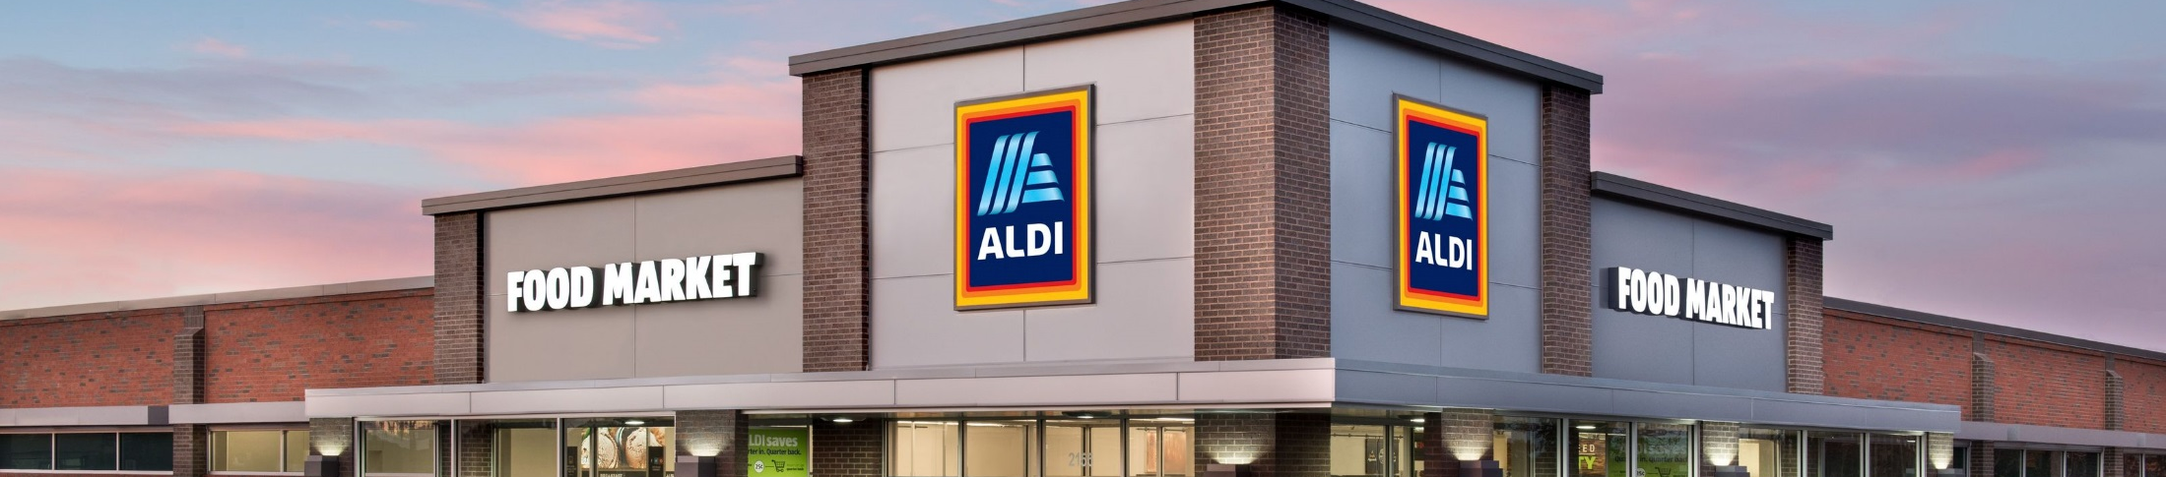




93%
61%
Selection of
Store Brand products &
Unique
products offered are liked at ALDI over
other retailers
FRESH PRODUCE
said that pricing/value drove them to ALDI
good/affordable price is what they liked about ALDI
(77%) was the top product purchased
With 1,600 Stores Today and Adding 900 More by 2022
ALDI Could be the Third Largest Grocery Chain
Half said their experience was Better Than Expected
1/3 shifting much more of their shopping to ALDI
Source: IRI ALDI Market Shift Study 2018

Slide 24
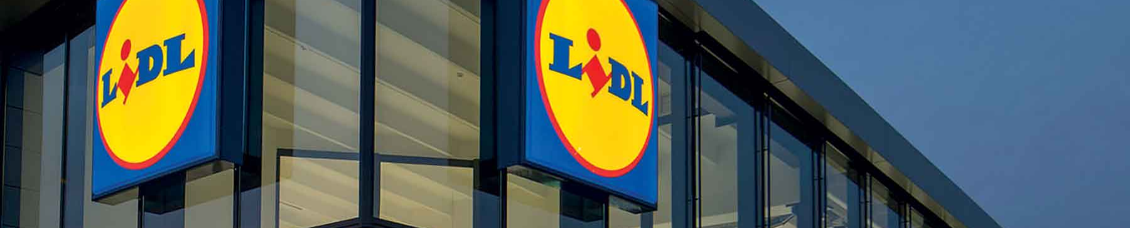





Lidl Enters the U.S.
40%
69%
70%
59%
64%
became aware by driving past the store
Fresh produce was the top product purchased
said Lidl offered good value for the money
liked the private brand assortment
said price & incentives drove them to the store
*Source: Deloitte, IRI Market Shift Study
Notes:
In their relentless focus on fresh, ALDI thinks creatively beyond traditional service limitations – expansive Grab-and-Go deli example
Testing 3,000 square foot “in-store bakery” expansion in Batavia, IL
Self-service model with breads, donuts, cookies and pretzels
ALDI’s ISB plans are in direct response to Lidl

Slide 25

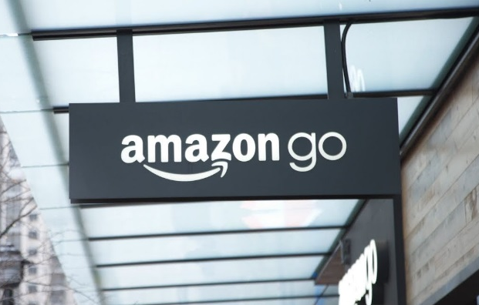
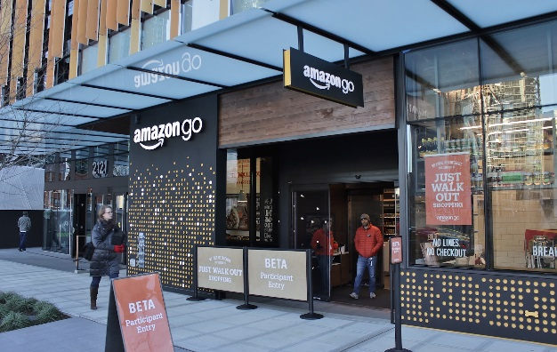
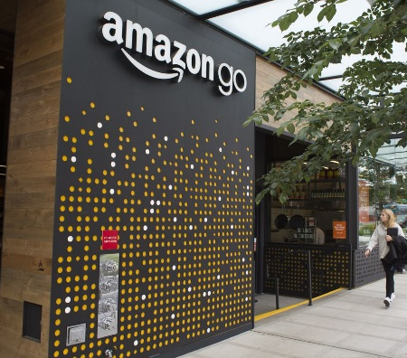
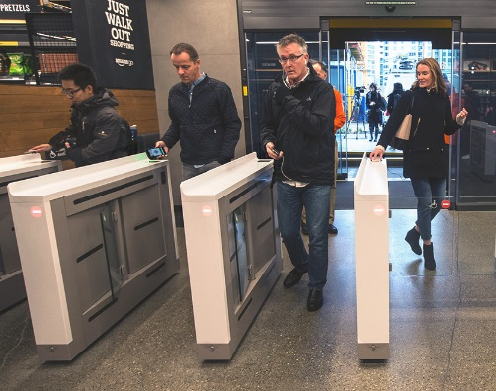
Amazon Will Consider Opening up to 3,000 Cashierless Stores by 2021
Amazon’s growing empire of brick-and-mortar stores could be both astonishing in its effects on communities and potentially a neutron bomb to everything from existing convenience chains like 7-Eleven to quick-service food stores like Subway and even entrepreneur-owned restaurants and taco trucks.
Bloomberg reports that Amazon CEO Jeff Bezos sees eliminating mealtime logjams in busy cities as the best way for the company to reinvent the brick-and-mortar shopping experience. It already has nearly 500 Whole Foods locations it can use as test platforms for new point-of-sale experiments, as well as a growing number of Amazon Go stores already operating near its HQ in Seattle and in Chicago.
Opening 3,000 stores of any model would put Amazon head-to-head with some of the largest brands in the world. By comparison, Kroger operates about 2,500 stores under a variety of brands that generate sales of more than $100 billion. There are a little more than 3,500 Walmart locations, but they’re mostly located in suburbs, away from the dense urban areas and affluent customers that Amazon is targeting with Amazon Go. Albertsons clocks in with 2,400 stores generating about $60 billion.
Source: https://www.digitaltrends.com/home/amazon-go-3000-stores-2021/
Notes:
https://www.focus-economics.com/country-indicator/united-states/retail-sales
Retail Sales Projection
https://www.thebalance.com/us-economic-outlook-3305669

Slide 26








We Are Witnessing the Biggest Revolution Food Has Ever Known
Estimated size of “click-and-collect” by 2020 67% say they’d use service a second time
$6.6B
77%
9
FEWER store trips annually for groceries
of retail sales will be influenced
5%
Increase in average basket size, price-driven
by digital with 1:1 potential
New Meals to Make
New Ways to Buy
52%
14%
Snack 5+ times per day – a +2.7 jump in one year. Consumers report eating many more, smaller meals since 2010
Say SPEED is the #1 or #2 highest decision factor when deciding dinner
70%
Gen Z (Born 1997 or later) influence more than of
Together, they are
household grocery shopping
47% of the US - diverse, digital & disruptive
Of US Hispanics are under age 40 One-Fifth of all Millennials
50%
New Consumers to Connect With

Slide 27
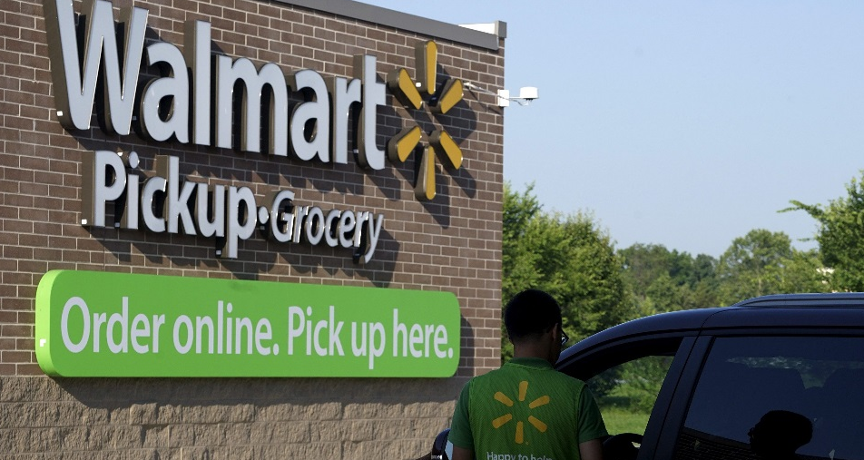
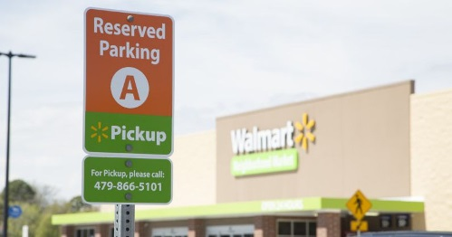
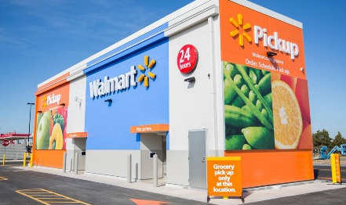
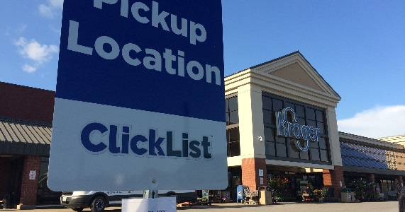
Click-and-Collect Has Become an
Important Part of Shopping
2020: $6.6B
Leveraging their existing infrastructure, retailers are investing in capabilities.
For food and beverage,
IRI expects that click-and-collect will total over $6.6B in 2020 up from $400MM in 2016
2016
$400MM
* based on IRI shopper survey and dollar share index

Slide 28
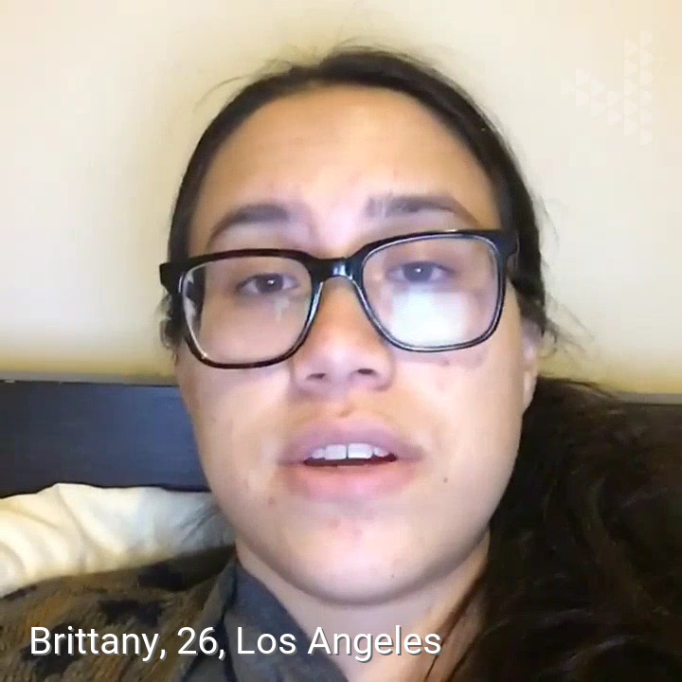
Conversion Opportunities by
Comparing Fulfillment Options
67%
50%
of click-and-collect shoppers say they would “definitely” use the service again
of users cite the time savings as
a motivation
Click-and-collect models are winning shoppers and driving online growth
for traditional grocery categories
* based on IRI shopper survey and dollar share index
Notes:
Click and Collect Video:
https://www.dropbox.com/s/5ahvu3bov5hwkct/TTIF%20-%20Delivery%20Showreel.mp4?dl=0

Slide 29
2018 Retail E-commerce Sales Are Expected to Reach $525.69 Billion
Amazon Dominates the Space
Top 10 U.S. Companies*
Ranked by Retail E-commerce Sales Share, 2018
% of U.S. retail e-commerce sales
Retail Sales E-commerce
U.S., 2018 – 2022
1. Amazon
49.1%
2. eBay
6.6%
3. Apple
3.9%
4. Walmart
3.7%
5. The Home Depot
1.5%
6. Best Buy
1.3%
7. Qurate Retail Group**
1.2%
8. Macy’s
16.0%
15.1%
1.2%
14.3%
13.9%
13.3%
9. Costco
1.2%
10. Wayfair
1.1%
2018
2019
2020
2021
2022
Note: Total U.S. retail e-commerce sales=$525.69 billion in 2018; top 10 companies* sales share=70.1 percent of total retail e-commerce in 2018; includes products or services ordered using the internet, regardless of the method of payment or fulfillment; excludes travel and event tickets; *excludes privately held companies; **includes
e-commerce sales for QVC, HSN and zulily as of 2018; prior years included QVC only
Billions % change
Source: eMarketer
Notes:
https://www.focus-economics.com/country-indicator/united-states/retail-sales
Retail Sales Projection
https://www.thebalance.com/us-economic-outlook-3305669

Slide 30
Groceries Are Amazon’s Fastest-Growing Category
Amazon Retail E-commerce Sales Growth,
by Product Category
U.S., 2018, % change
Despite forays into food and beverage with Amazon Fresh, Amazon’s acquisition of Whole Foods was a loud and clear signal that the online retailer was invading the traditional supermarket space.
Food is one of the most underpenetrated digital sales categories in the U.S. Only 2.8 percent of food and beverage sales occurred online in 2018, according to eMarketer. So the retailer that solves the logistical issues of getting perishables to shoppers quickly and cost-effectively stands to gain exponentially.
With $4.75 billion in 2018 sales, food and beverage also ranked last by product category. However, food and beverage posted sales growth of 40.1 percent versus 2017, tops among all categories.
Auto & Parts 29.4%
Apparel & Accessories 38.2%
Books, Music & Video 18.9%
Computer & Consumer Electronics 23.0%
Food & Beverage 40.1%
Furniture & Home Furnishings 37.2%
Health, Personal Care & Beauty 37.9%
Office Equipment & Supplies 29.4%
Toys & Hobby 30.7%
Other Categories 30.4%
Source: eMarketer
Notes:
https://www.focus-economics.com/country-indicator/united-states/retail-sales
Retail Sales Projection
https://www.thebalance.com/us-economic-outlook-3305669
According to eMarketer's latest forecast, Amazon's e-commerce share of food and beverage sales in the U.S. will reach 31.8 percent in 2018. And with $4.75 billion in sales, food and beverage will also rank last by product category. However, food and beverage will post sales growth of 40.1% this year, tops among all categories.

Slide 31
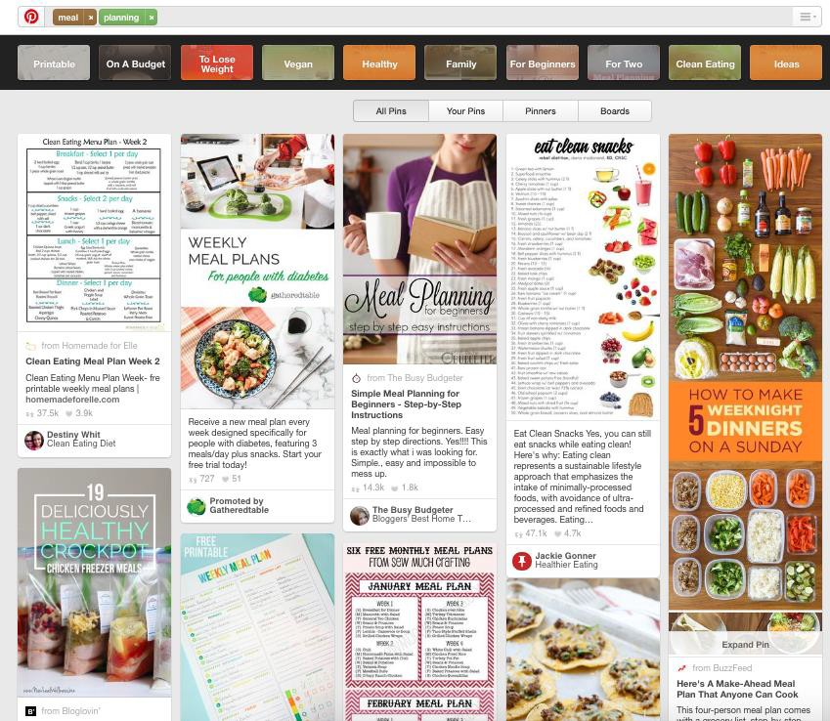
Consumers are Leveraging Online Resources to Research Ways to Use the Products They are Going to Buy
Total | Millennials | GenX | Younger Boomers | Older Boomers
Desktop/Laptop
7% | 11% | 5% | 5% | 4%
Smartphone/Tablet
14% | 26% | 14% | 10% | 0%
Source: IRI 2018 Fresh Digital Survey

Slide 32
CPG and Consumer Products Brands Spent $9.40 Billion on Digital Ads
U.S. CPG and Consumer Products
Digital Ad Spending ($B)
U.S. Digital Ad Spending Share
by Industry, 2018 (% of total)
Retail
Automotive
Financial Services
Telecom
CPG and Consumer Products
Travel
Computing Products
Media
Entertainment
Other
2016
2017
2018
2019
Health Care and Pharma
Spending on digital ads increased 18.7 percent in 2018, equal to the average growth in digital ad
spending for all industries. Growth will remain strong in 2019, when spend will rise 17.3 percent.
Source: eMarketer

Slide 33
% of CPG Categories With Increasing Merchandising Activity
Volume Sales growth in Tobacco and Home Care due to promotional activity
Volume Sales growth in Beverage, Frozen, General Foods and Health but promotional activity is down.
Why?????
YA
CY
Beverages
Frozen
General Food
Liquor
Refrigerated
Beauty
General Merchandise
Health
Home Care
Tobacco
Volume Sales % Chg. vs. YA
0.7% | 1.4% | 0.0% | -0.1% | -0.5% | 0.7% | -2.0% | 2.1% | 4.2% | 8.6%
Source: IRI Market Advantage™, MULOC, 52 weeks ending Dec. 2, 2018 vs. YA

Slide 34
Trade and consumer promotions are evolving and creating impact
Traditional trade promotional tactics:
  OIs
  Billbacks
  Scan backs
  Ad features
  IRCs
New trade promotional tactics
  Load to card
  Click n Collect
  Supporting account specific digital efforts
  Coupons.com
  Shop Kick
  IBOTTA
Source: Supermarket News Feb. 2019

Slide 35
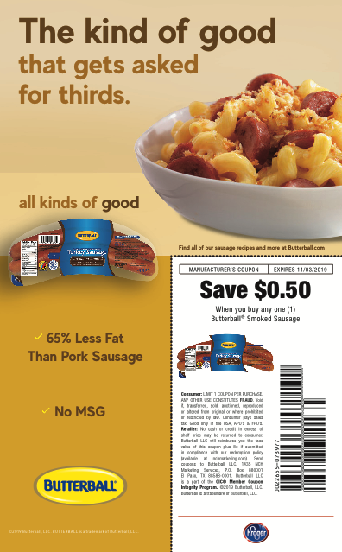
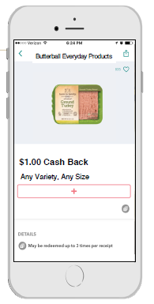
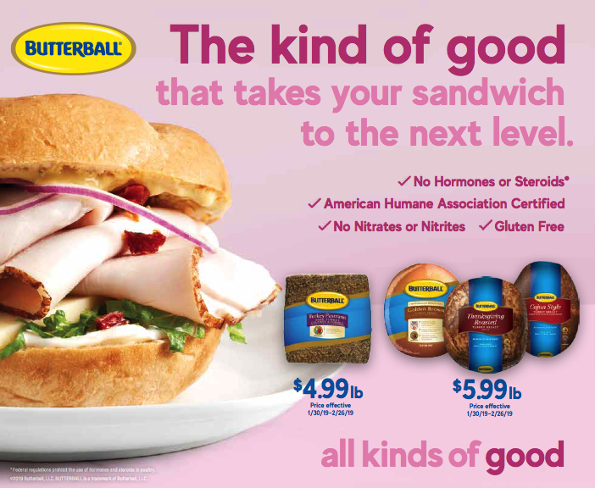
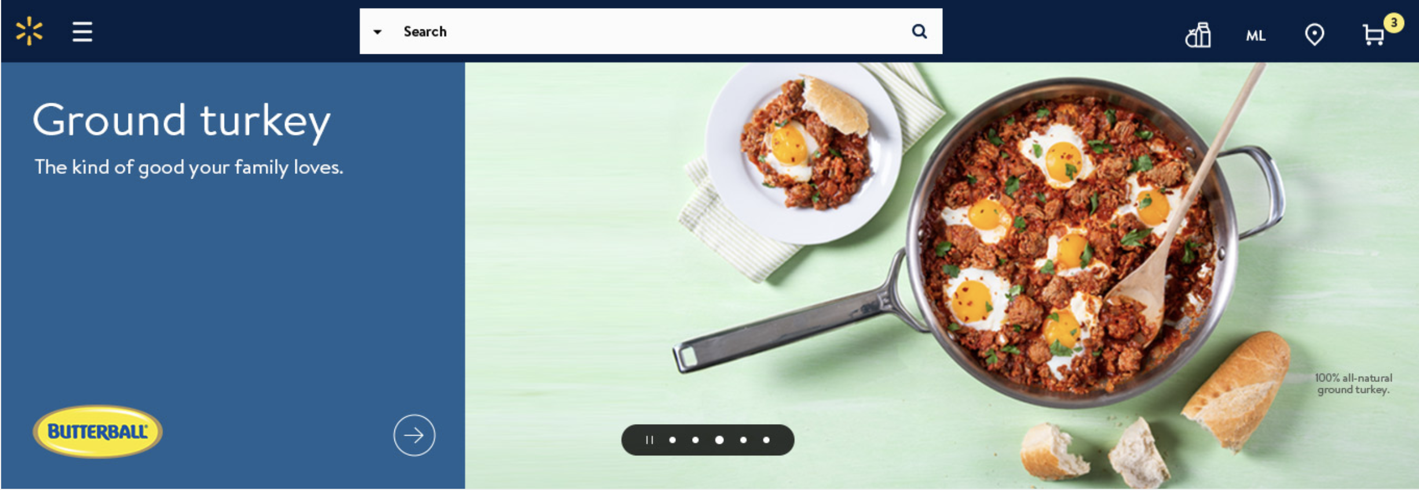
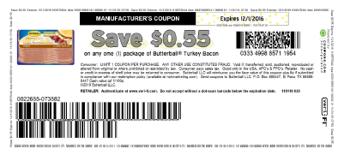
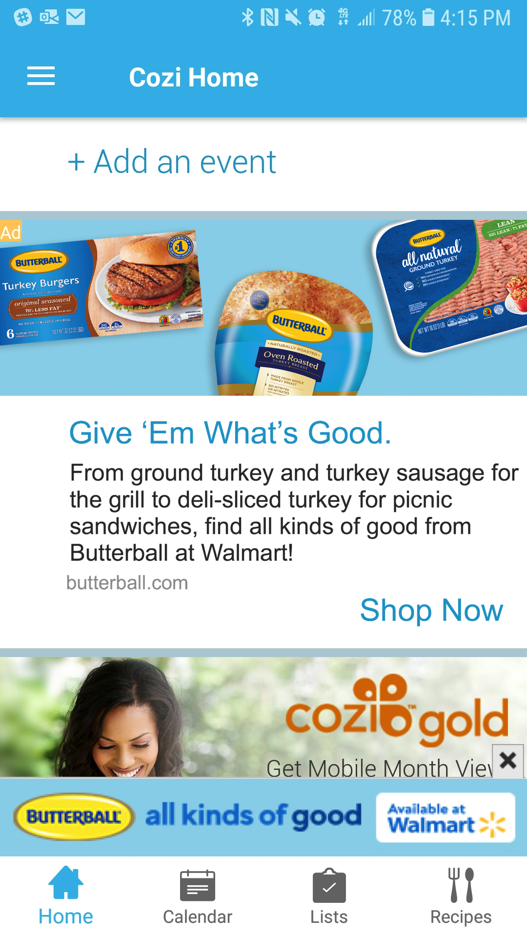
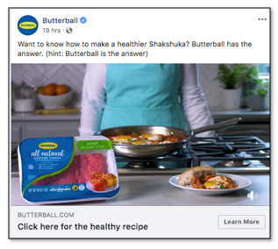
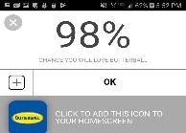
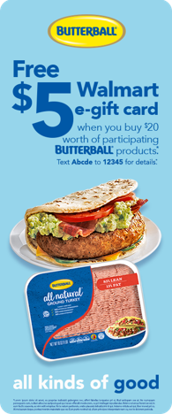
Examples of new trade and consumer promotional tactics
Account Specific Print – Kroger My Mag, Jewel Big Book
Receipt Based Programs – Ibotta & ShopKick
Account Specific Websites – Walmart.com
Print at Home Digital Coupons
Shopping Apps - Cozi
Targeted Digital Media - Banners and Video
Paid Social Media

Slide 36





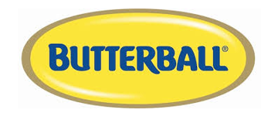

Trade System Functionality and Users
Analytics
Dashboards
Aging and balances
Ad hoc reports
Post event analysis
Planning
  Sales forecast
  Budgeting
  Promotion planning
  Review customer and/or promo group P & L
Financial Integration
Accruals
Monitor Accruals
Settlement
Adjustments
Program Creation
Rule Entry
Contract parameters
Approvals
Rebate Processing
Customer rebate tracking
Alerts
Approvals
Order/Claim Processing
Order pricing
Program visibility
Claim validation
Store Claim Back Up
Sales
Brokers
Supply/Demand
Finance
Exec
Notes:
Randi

Slide 37
Top US Retailers and Wholesalers continue to consolidate
CPG is steady but only experiencing modest growth
Alternative channels are growing at a rapid pace
Consumer are becoming more and more familiar with digital engagement when it comes to grocery shopping
On line shopping for food and beverages are growing
Need to select the most effective consumer marketing promotions as well as merchandising activity
Having a comprehensive trade management system is the key to evaluate all the promotional options that are offered today

Slide 38
Channel Breakouts:
Foodservice
Retail
Julie Michel – Rich Products
Tina Wefer and James Miller – FSICI
Redi Group Chat – led by J.R. Simplot
John Weller – Blacksmith Applications
Mike Bruening – Genpact

Slide 39


Claims and Proof of Delivery Automation (CPA)
Julie Michel
Rich Products
Notes:
30 min

Slide 40

High Radius
Claims and Proof of Delivery Automation (CPA)
  Efficiency - Streamlines the process by reducing the time required to retrieve backup from various customer websites
  Standardization gained by retrieving data from one source- Documents are indexed and stored uniformly.
  All formats are downloaded; and development to have excel documents created for certain customers.
  Documents are sent to our Document Repository – OnBase (connected to Deduction in Blacksmith) Immediate access to deduction backup equates to improvement in Average Age of Open deductions. Ave Age decreased by 53% in 2018. CPA was a factor in the reduction.

Slide 41







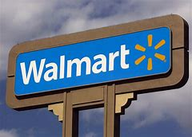
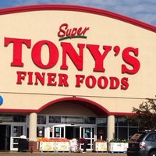




Via Portal:
U.S. - Food Service Division
U.S. – In Store Bakery & Retail Divisions
Canadian Division

Slide 42




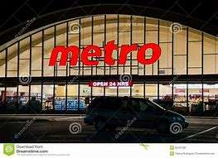
Via email:

Slide 43
YTD 2019 Stats
 | Y2019
Agent | Jan | Feb | March | April
Ahold | 64 | 110 | 110 | 101
Associated Food Stores | 45 | 29 | 29 | 33
AWG | 98 | 76 | 84 | 111
BJ's Wholesale | 27 | 11 | 11 | 17
Dot Foods | 90 | 111 | 102 | 127
Jetro/RD | 2 | 2 | 2 | 7
Kroger | 937 | 796 | 174 | 0
Loblaw | 36 | 21 | 20 | 34
Maines | 2 | 2 | 1 | 3
Meijer | 10 | 10 | 12 | 19
Metro | 26 | 21 | 22 | 25
PFG | 22 | 6 | 3 | 23
Safeway | 92 | 108 | 76 | 97
Sobeys | 108 | 144 | 145 | 171
SpartanNash | 19 | 23 | 23 | 24
Sysco Canada | 553 | 139 | 139 | 166
Target | 28 | 48 | 20 | 29
UNFI(Supervalu) | 691 | 682 | 750 | 781
Wakefern | 32 | 33 | 22 | 24
Walmart | 261 | 136 | 161 | 51
Winco | 45 | 3 | 7 | 1
Grand Total | 3188 | 2511 | 1913 | 1844
**** Kroger had 0 for April because they changed platforms so we haven't had aggregation in a month

Slide 44


V6 – implemented Blacksmith in 2012
V8 – Upgraded in April 2019

Slide 45
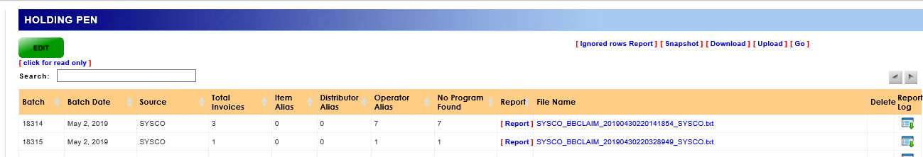
Holding Pen - EDI
On average 1.5K – 2K in monthly Billbacks for Sysco
70% Work in Progress (WIP) Average Monthly
  Old Process in V6
  New Process in V8 – Holding Pen
    EDI claim data that does not have alias records created go to the Holding Pen
    After missing alias records are created user can reprocess billbacks from the Holding Pen

Slide 46
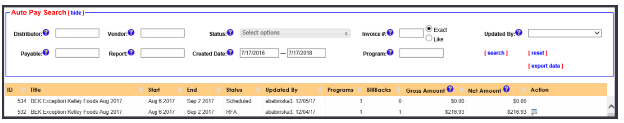
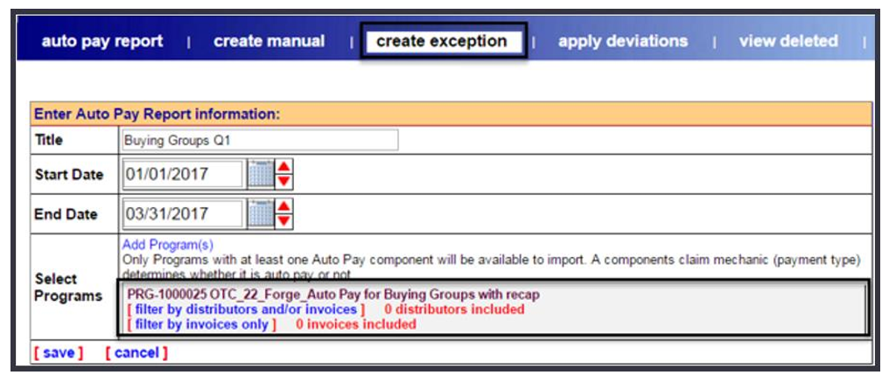
Auto Pay
New Search Options
New Exception Functionality
Other Key features:
Program Pacing
Monthly Summary
Open Pay Periods

Slide 47
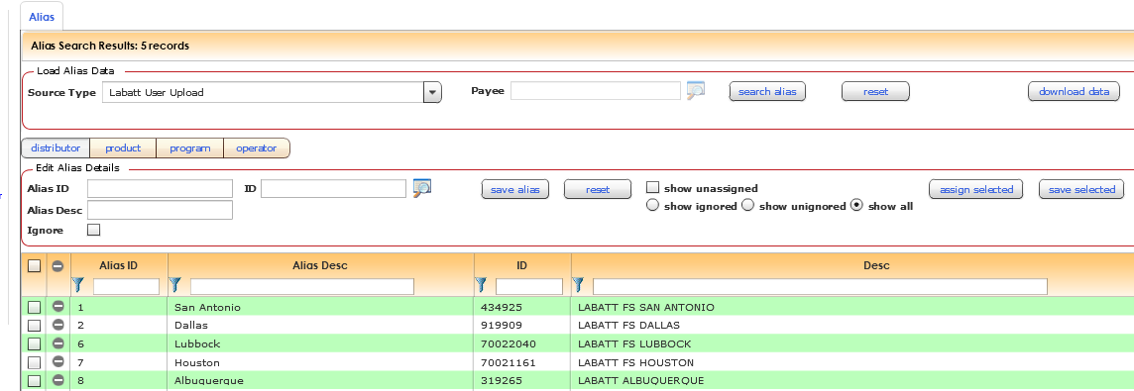
Upload Payables
  Old Process in V6 – 5 customers out of 3 division utilized Dual File Upload
  New Process in V8 – Upload Payables – Billback Upload
    Labatt & Sodexo examples to share

Slide 48
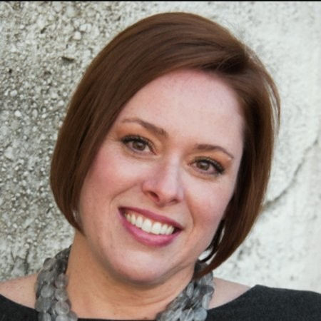

9.3 Million Reasons to Take Action
Tina Wefer
FSICI
Notes:
30 min

Slide 49

9.3 Million Reasons
to Take Action
FSIC
JAMES MILLER
TINA WEFER

Slide 50




















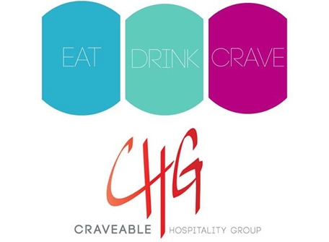




FSIC: A Leader in Restaurant Supply Chain Transparency & Compliance
200
Brands Serviced
10,500
Manufacturers
500
Distributors
500,000,000+
Client Savings Identified
2.5-10%
Client Savings
7,000+
Mfr. Contracts
2001
Founded
1,500+
Dist. Contracts

Slide 51
GPO OVERSPENDING STATS
Operators Receive a Small Portion of Your GPO Spend
$9.3 MILLION
$2 BILLION+
25%
43 %
96 %
Operators Receive
on Average
Minimum Double-Dip
Highest Double-Dip
Awarded to Gregory Packaging
Billed Back
Each Month
Based on FSIC client data
In Gregory Packaging-Foodbuy Lawsuit
By one of the largest GPOS

Slide 52


NOW IS THE TIME… JOIN OUR INDUSTRY WORKING GROUP
MISSION
Gather Foodservice executive input into practical and feasible solutions that the industry can implement to reduce the data and reporting challenges that exist in order to better report and pay on GPO programs and reduce double-dipping.
BRING ABOUT CHANGE
We are hearing across the industry that companies want to bring resolution to these challenges. We will discuss actions and other potential opportunities to drive cost out of the system
BE INVOLVED
We have formed this working group to bring together the best minds in the industry who desire change enough to bring about a solution.
CONTACT
Reach out if you are interested: Tina Wefer (CSO) Chief Strategy Officer at FSIC, twefer@fsici.com

Slide 53





COLLABORATORS

Slide 54
POTENTIAL MANUFACTURER ACTIONS
1
Require all billbacks to have client info (29 elements) as well as if they are part of a restaurant group/chain and what it is.
Send out email/letter that all current billback clients need to sign and return, indicating that they are still part of the GPO program. This should be done annually.
Conduct intensive audits of data. Technology is available to validate billbacks.
Require proof that the Operator is paid.
Work with distributors on a Manufacturer Participation Program for independent operators direct to pass on 90% to the operator.
Demand distributor and GPO accountability.
Just say no to programs without transparency and accountability.
2
3
4
5
6
7

Slide 55

Redistribution Group Chat
Join the team from Simplot for this hot topic

Slide 56


Redistribution & Foodservice
Not without its unique challenges…
Operator Programs where we know Redistribution will be used
Protecting the Redistributor’s margin
Operator Rebates, anyone?
Distributor Deductions made through the Redistributor (LMF, etc.)
Obvious invalid deductions for items we don’t manufacture
EDI for deductions
Does the pricing philosophy change depending on the Redistributor
The secret to tracking profitability with Redistribution
Services like Dot Expressway

Slide 57

Challenges to Meaningful Post-Event Analysis
John Weller
VP Product Management, Retail TPx

Slide 58
Background:
Founding partner of T-Pro Solutions
  Past 5 years focused on advanced analytics and optimization for Retail TPM
25 years designing and implementing Retail TPM solutions
  Software vendor
  Independent consultant

Slide 59
End Goal
What is the end goal for mature post-event analysis (PEA)?
To be able to accurately calculate…
Incremental Volume
Incremental Revenue
Incremental Profit
Return on Investment (ROI)
Definitions
Incremental - Volume, revenue, profit above and beyond “base” expectations
Base - Different definitions for different purposes. For the purposes of PEA - Volume, revenue, profit we would expect in the absence of a promotion (i.e. normal turn business)

Slide 60

Challenges
While to concepts are pretty straight-forward, the implementation is quite challenging!
Most challenges are data-related
Process deficiencies often the root cause of data-related challenges

Slide 61
Challenges
Challenge #1 - Having the right data to determine incremental
Data Sources
Shipments:
Can you determine a non-promoted baseline?
Can you tell what was actually consumed (vs. warehouse loading)?
How does diverting impact the analysis?

Slide 62
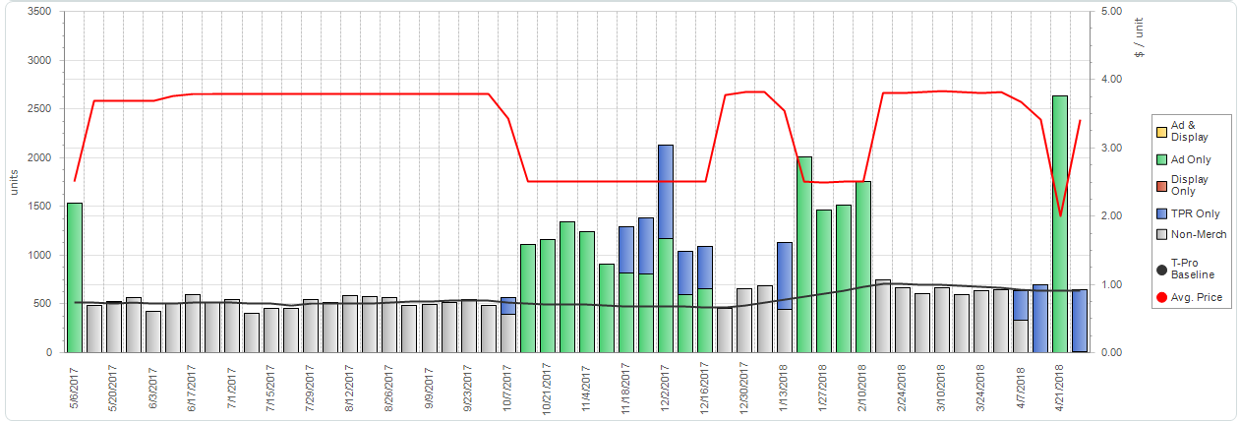
Challenges
Challenge #1 - Having the right data to determine incremental
Data Sources
Consumption (POS):
Does this provide a good estimate of the volume we would expect in the absence of a promotion?
Does this provide a clear view of total consumption from which we can calculate incremental?
What other insights does it provide?

Slide 63
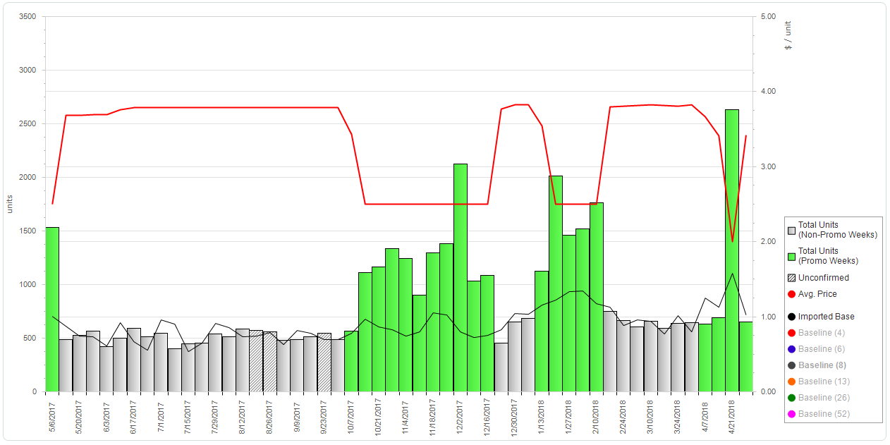
Challenges
Challenge #2 - Determining the correct baseline
Does using syndicated consumption data solve all of your baseline challenges?

Slide 64
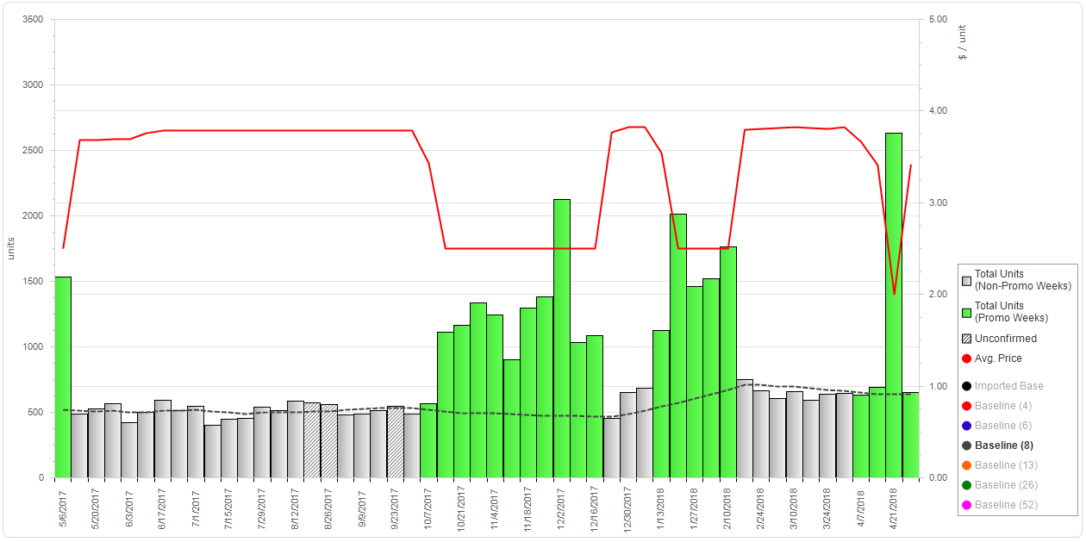
Challenges
Challenge #2 - Determining the correct baseline
Ideal baseline…

Slide 65
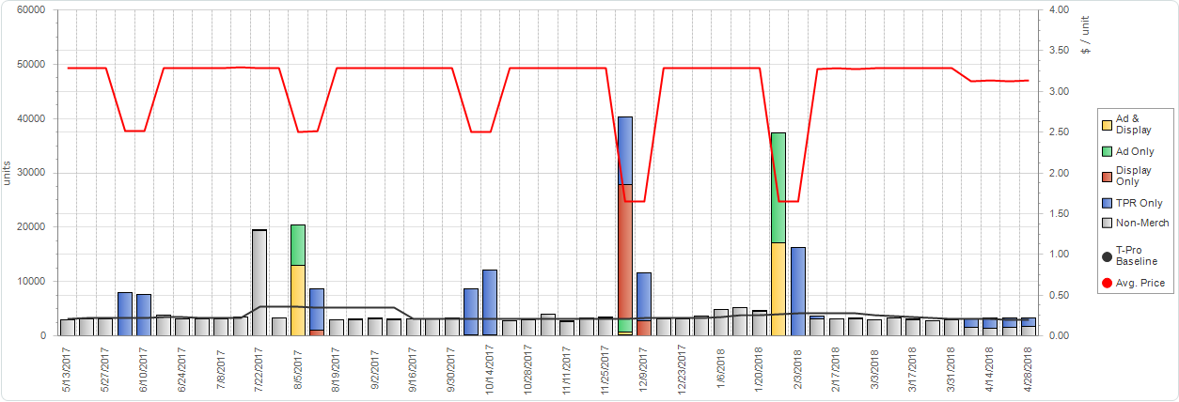
Challenges
Challenge #3 - Data Anomalies
What is the impact of volume anomalies?
What is the impact of retail price anomalies?
How can you correct them?

Slide 66
Challenges
Challenge #4 - Getting the all data sources data to the correct account and product level
  Accounts
  Multiple definitions within internal systems (e.g. ship-to, bill-to)
  Key Account definitions within syndicated POS data
  Products
  Multiple definitions within internal (e.g. SKU, case pack)
  UPC level vs. “industry subtotals” within syndicated POS data
Well-designed/implemented TPM solution generally takes care of internal definitions
POS data almost always requires mapping/aggregating

Slide 67
Challenges
Challenge #5 - Trade spending data with sufficient accuracy/granularity
  Is your trade spending explicitly tied to the promo events?
  Is your trade spending assigned to the correct account and product level?
  Is your trade spending appropriately allocated to the products on the events?

Slide 68

Challenges
Challenge #6 – Bringing it all together
Once you have all the data at the right level and it is cleansed…
  How do you align consumption with trade events?
  How do you apply financial information (e.g. list price, COGS)
  What tools – Generic (Excel, BI) or purpose built
  What skills and level of expertise are required

Slide 69

Conclusions
Robust post-event analysis is a journey
Much of the success depends on laying the proper foundation
For many manufacturers, far more time is spent organizing and cleansing the data than spent actually analyzing results
The payback is huge
Get started – Don’t wait for everything to be perfect

Slide 70
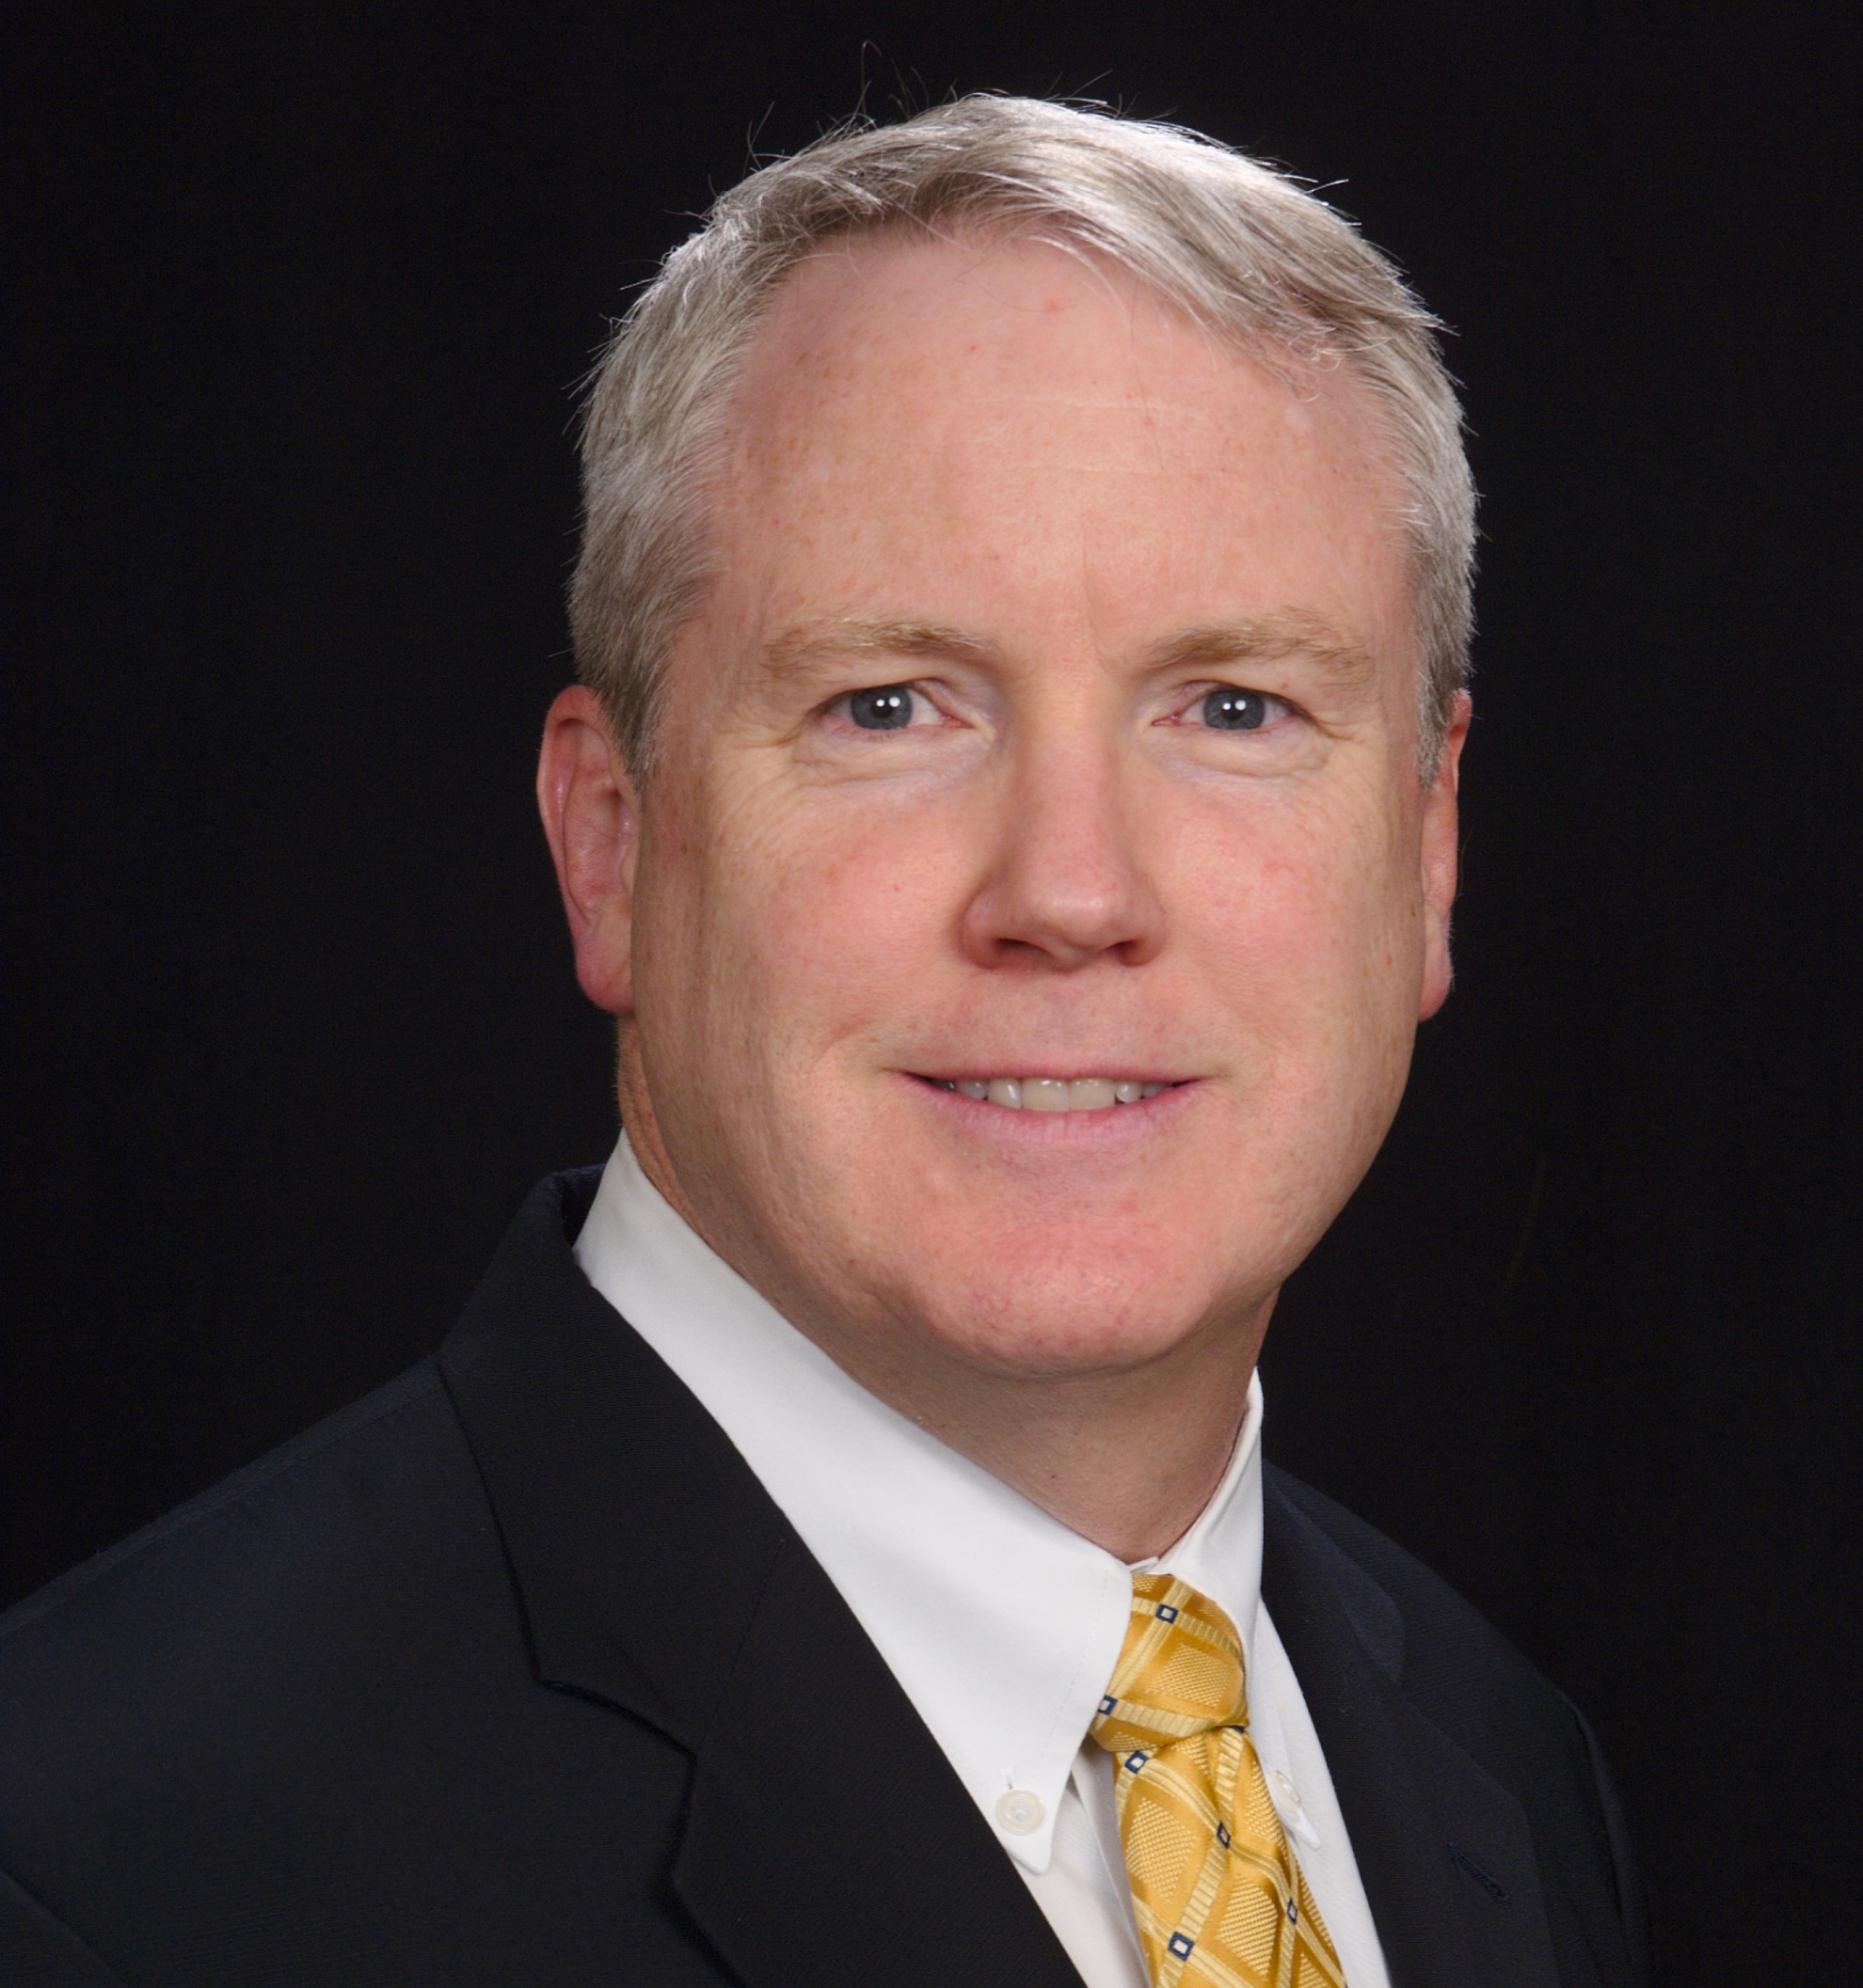

AI and Machine Learning Impact on Consumer Goods Industry
Mike Bruening
AVP Artificial Intelligence
– Consumer Goods

Slide 71


ar·ti·fi·cial in·tel·li·gence
/ˌärdəˈfiSHəl inˈteləjəns/
Noun
the theory and development of computer systems able to perform tasks that normally require human intelligence, such as visual perception, speech recognition, decision-making, and translation between languages.

Slide 72
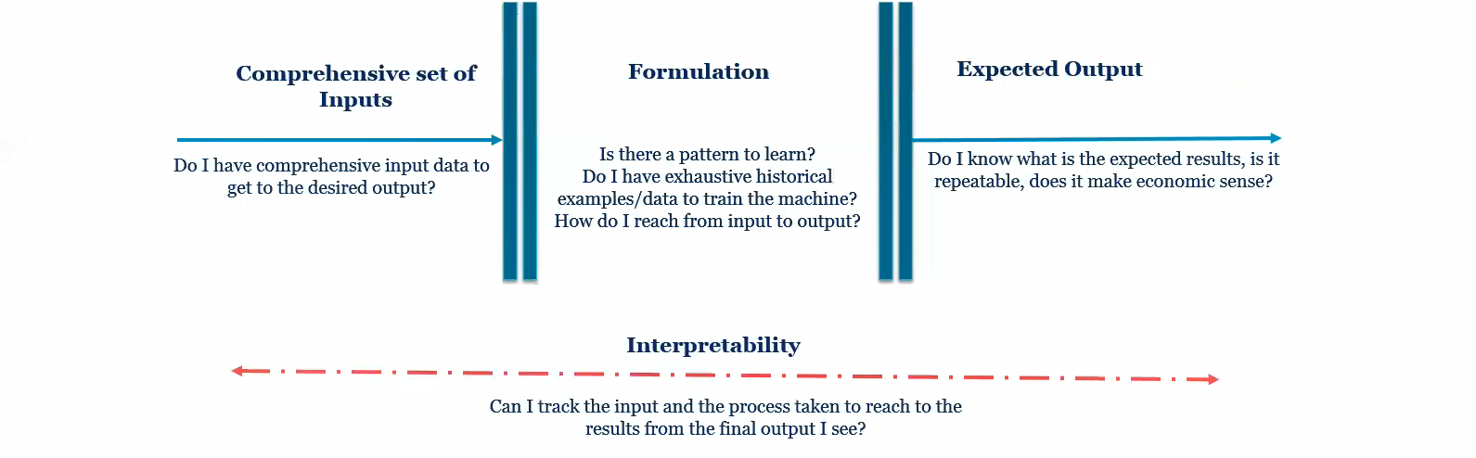
Machine Learning
“Machine learning as a discipline tries to design, understand and use computer programs that learn from experience for the purpose of modeling, prediction or control.” - MIT Definition
In simple terms, ML is the ability of a machine to learn from experiences it is exposed to so as to apply learning to solve a problem without the need of any explicit programming.

Slide 73
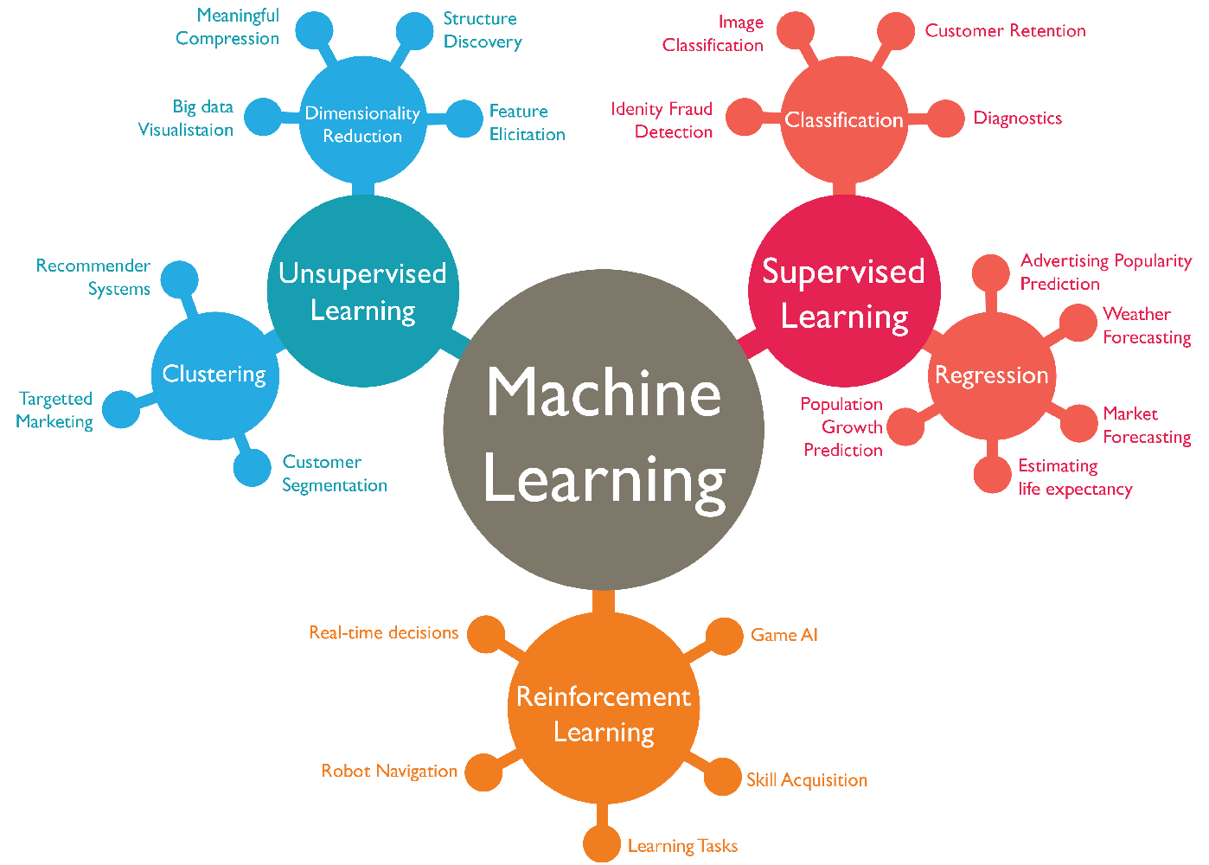
Machine Learning Applications

Slide 74
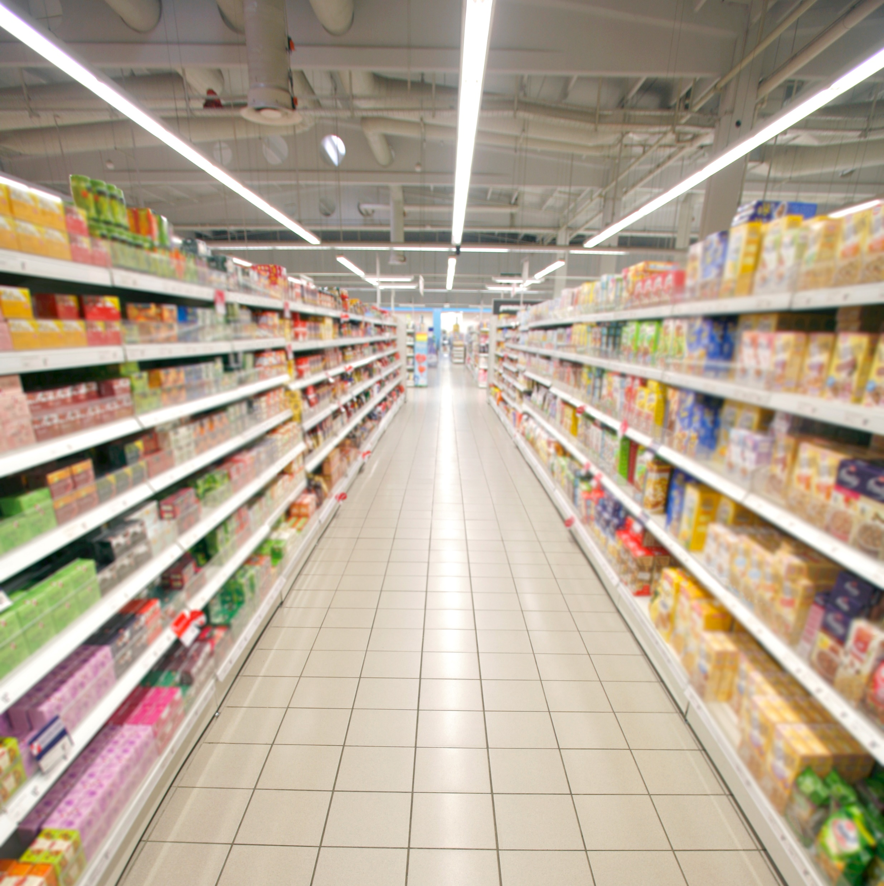

Why CPG and AI are a Good Fit

Slide 75
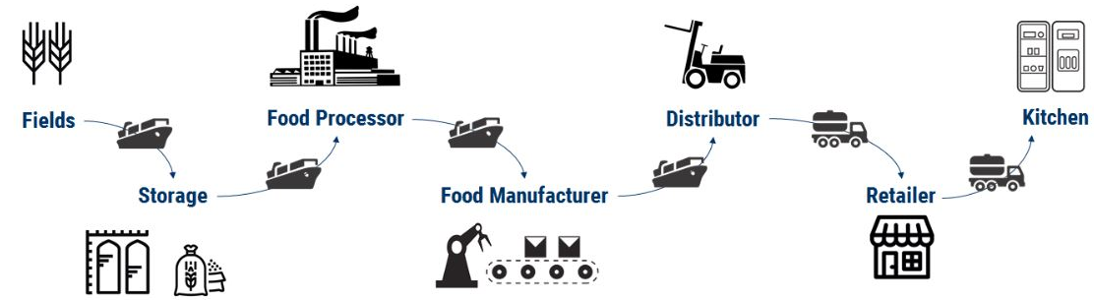
Internet of Things

Slide 76
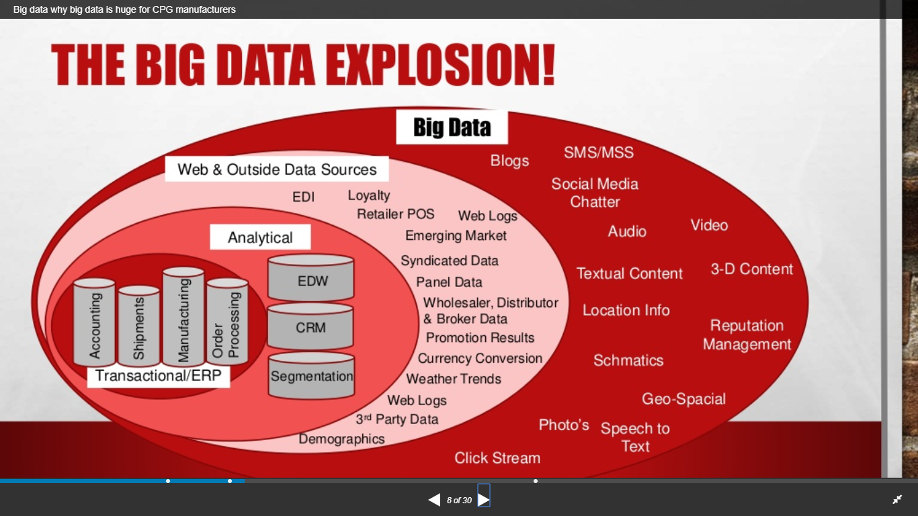
Big Data

Slide 77
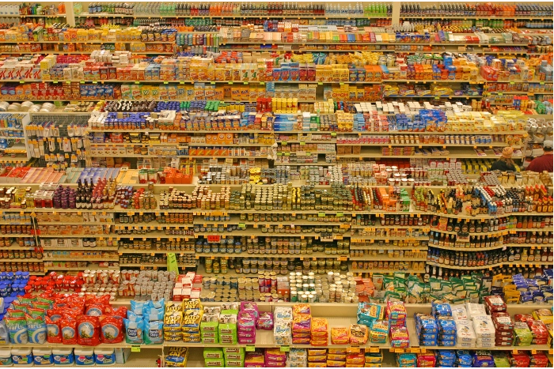
Size and Scale of Industry

Slide 78
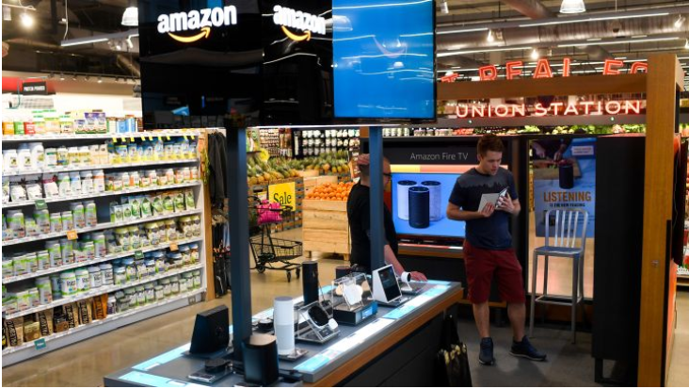
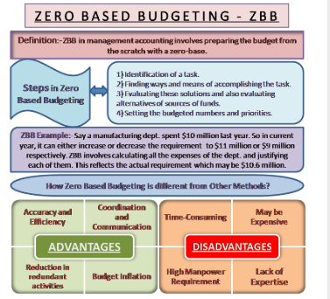

Time of Change
1
3
2

Slide 79
AI Solutions
NUMBERS
SPEECH
PICTURES
VIDEOS
TEXT
Machine Learning
Conversational AI
Computer
Vision
Natural Language Understanding

Slide 80




AI Solutions - Numbers
NUMBERS
Machine Learning

Slide 81



AI Solutions - Speech
SPEECH
Google Translate
https://translate.google.com/
Google's free service instantly
translates words, phrases, and
web pages between English
and over 100 other languages.
Conversational AI

Slide 82



AI Solutions – Pictures / Videos
PICTURES
VIDEOS
Computer
Vision

Slide 83




AI Solutions - Text
W
E
B
S
I
T
E
S
E
M
A
I
L
S
TEXT
C
O
N
T
R
A
C
T
S
I
N
V
O
I
C
E
S
Natural Language Understanding

Slide 84


Robotics and AI

Slide 85

The Future of AI

Slide 86
How to get started
Access your company’s Digital / Analytical Culture
Look for areas of friction in your business
Forecasting, Ordering , Out of Stocks, Retail Execution
Experiment with Proof of Concepts
Understand the boundaries of capabilities of AI and Machine Learning

Slide 87

Opening
Up to Optimization
Terry Ziegler
General Manager, Retail TPx

Slide 88
“There is far too much money at stake for companies to continue inefficient, unprofitable practices: Gartner finds that as much as 67% of trade programs don’t break even.”
- Peter Breen, Editor CGT Magazine

Slide 89




Obstacles to Trade Promotion Success
Data Quality
and Availability
Spreadsheets
and Time
Increased
Competition
Compressed
Margins
To build top-line and bottom-line growth today’s CPG must use their data in ways that make them more efficient, more competitive and more profitable.

Slide 90


The Drive to Get Better
What do we need
to get better?
From POI 2019 State of the Industry

Slide 91


What is Trade Promotion Optimization?
How much are we spending - investing?
How well is it working?
How can we do it better?
What if… What else…?
Baseline Automation & Integrity
Post-Event
Analysis
Central Data &
Intelligence
Hub
Customer Optimization
“What If” Scenario Planning

Slide 92
Addressing the Obstacles
Data Quality
and Availability
Spreadsheets
and Time
Increased
Competition
Compressed
Margins
With TPO
Automate cleansing and harmonization
of POS, Shipment, Spending Data
Eliminate spreadsheets with centralized analysis and planning.
Integration into TPM
Monitor and compare promotional performance with competitor activity.
Measure ROI and promotional effectiveness.
Optimize for revenue, profit, and volume

Slide 93
The Trade Promotion Eco-System
Optimization
Post-Event Analysis
Corporate and Account Planning
Execution
Settlement
WHY TPM? – How much?
Gain visibility to overall net revenue
Manage deductions, settlements, accruals
Centralize planning, budgeting, trade execution
TRANSACTION FOCUSED
WHY TPO? – How efficiently and how to improve?
Quantify return on trade investment
Gain visibility to base and promotional trends
Make more informed, predictable planning decisions
Improve trade investment analysis and planning processes and outcomes
ANALYTICS FOCUSED

Slide 94
5 Critical Components
Data Harmonization
Eliminate data siloes by automatically bringing together
POS, Shipment, and Spending data for accurate analysis.
Baseline Accuracy
Avoid overstated baselines estimates and eliminate data anomalies to create more accurate lift-coefficients.
Baseline Automation & Integrity
Post-Event
Analysis
Post Event Analysis
Central Data &
Intelligence
Hub
Quickly evaluate ROI, plan vs actual, and other important
KPIs including competitor activity.
Predictive Planning
Perform What-if event and customer planning scenarios to predictively see incremental lift, profitability and ROI for you and your retail partners.
Customer Optimization
“What If” Scenario Planning
Constraint-Based Optimization
Apply machine learning and AI to identify the best fit promotion or promotional mix to meet your budget and company objectives.

Slide 95

TPO Myth vs Reality
Myth: You must be a large CPG company to see meaningful benefit from a TPO solution
Reality: It is not the size of the company that determines success, but the access to the right data and an organization dedicated to using it to make better decisions.
Example:
Companies with products in only 1 category
Companies with only 1 trade analyst
Companies with multi-billion dollars in sales

Slide 96

TPO Myth vs Reality
Myth: If I have access to syndicated data, these baselines provide me with the best representation of my base business.
Reality: Syndicated baselines can overstate baseline volume during a promotion. This is because they include assumptions about loyal customers pantry loading. A trade marketing baseline is what a consumer would buy in the absence of a promotion.

Slide 97

TPO Myth vs Reality
Industry Example:
Many companies try to create their own baselines manually. This is time consuming and error-prone. A TPO solution should automate baseline smoothing using POS data and can be specific to products
and categories.
Syndicated
Baselines

Slide 98

TPO Myth vs Reality
Myth: I do not have the time or resources for a
TPO implementation
Reality: TPO integrates directly into your TPM or sales planning tool. It does not require complicated mappings. Therefore, there is minimal IT involvement and can be implemented in a few months.

Slide 99


Week 1: Business Process Review
Weeks 2-5: Mapping and database configuration
Week 6:
Proof of Concept
Weeks 7-8: Mapping and configuration revisions
Weeks 9-10: Roll Out,
User Training
TPO Myth vs Reality
Industry Examples:
Typical timeline
1 Trade Analyst
Low IT involvement
The move to TPx
6 Months for TPM Implementation
TPM & TPO
“Learning” & Usage
2-3 Months for TPO
Annual Quantified
Return Starts
Here
And continues moving forward
6-10 weeks
Implementation

Slide 100

TPO Myth vs Reality
Myth: It takes too long to see the benefits of implementing a TPO solution.
Reality: A TPO solution provides immediate visibility to promotional performance and the ability to apply this insight to quickly course correct or improve future planning. Companies using TPO experience a quantified annual return on their trade investment resulting in an exponential payback on solution cost.

Slide 101





TPO Myth vs Reality
Industry Examples:
Company A:
Hit budgeted volume and spend for 1st time in a decade
Company C:
2% Net Revenue increase
6 % Reduction
in Trade
Spend
Company E:
18 Basis Points of Incremental Revenue in
first year
Company D:
65% Increase in analytical efficiency
Now able to analyze 400% more
accounts
Company B:
3 consecutive years of
record
results

Slide 102

Where to start?
According to the 2019 POI State of the Industry Report
“POI’s current recommendation is to implement a seamless holistic planning platform, or
first implement TPO and optimize planning to
drive increased revenue and profits.
Manufacturer leadership can then use the efficiency savings to fund TPM and transactional elements. “

Slide 103
Takeaways
Trade Promotion Optimization will help your company…
Quantify return on Annual Trade Investment
Make more informed, better investments
Protect and improve your investment with revenue management planning guardrails and constraints
Align business objectives and trade investment outcomes
Improve business processes – save time, gain accuracy,
empower your people
Prioritize better collaboration with retail partners

Slide 104
TPM Trends & Advanced Analytics
Paul Wietecha
President & CEO, Blacksmith
Notes:
30 min

Slide 105
Placeholder
Pending slides from PW

Slide 106
Snack Time!
Chicago - May 9, 2019
Notes:
Hummus, pitas and veggies

Slide 107
Blacksmith Applications Achievement Awards
Chicago - May 9, 2019

Slide 108

Blacksmith Applications
Achievement Awards
Excellence in Systems Innovation

Slide 109

Blacksmith Applications
Achievement Awards
Excellence in Multi-Channel Trade Management

Slide 110

Blacksmith Applications
Achievement Awards
Best Practice in Deduction Management

Slide 111

Blacksmith Applications
Achievement Awards
Business Partnership Award

Slide 112


Blacksmith Applications
Achievement Awards
Excellence in Optimization

